Slide 1

Feasibility Survey for Core Readiness work
Kalaiya to Chapur
Ncell
ZTE

Slide 2

Bypass proposed length
From | Towards | Distance(KM) | Proposed length(M) | Bypass type
NAR014 | NAR402 | 3 | 2500 | UG(15joints)
NAR014 | NAR402 | 12.1 | 600 | 300 UG 300 ADSS
NAR014 | NAR402 | 16.4 | 1500 | 1400 UG 100 ADSS (GI required)
NAR014 | NAR402 | 20.5 | 1500 | 500 UG 1000 ADSS
NAR014 | NAR402 | 24.2 | 2200 | 700 UG 1500 ADSS
NAR014 | NAR402 | 29.5 | 500 | ADSS
NAR014 | NAR402 | 37.5 | 3000 | 2500 UG, 500 ADSS
NAR402 | NAR014 | 40 | 3500 | 2000 UG 1500 ADSS
Total Length |  |  | 15300

Slide 3
NAR014-NAR402 Rework Feasibility Survey
Proposed to rework for the core readiness work in Kalaiya to Chapur route and OTDR distance is approx.90km.
Previously road was narrow and after road expansion and culvert construction area there was maximum cut whereas during link restoration all cores are not spliced and buried inside road before handover.
Existing fiber lies inside the road in market area and culvert construction area whereas remaining section fiber lies in personal property(paddy area).
NAR402-NAR050 route | Core used | NAR050-NAR014 route | Core used
NAR402-NAR050 | 1 | NAR050-NAR014 | 2
NAR050-NAR410 | 2 | NAR050-NAR190 | 2
NAR402-NAR464 | 1 | NAR190-NAR130 | 2
NAR464-NAR427 | 2 | NAR130-NAR074 | 2
NAR427-NAR346 | 2 | NAR074-NAR447 | 2
NAR427-NAR405 | 2 | NAR447-NAR153 | 2
NAR346-NAR405 | 2 | NAR153-NAR045 | 2
NAR405-NAR156 | 2 | NAR045-NAR223 | 2
NAR156-NAR426 | 2 | NAR223-NAR041 | 2
NAR426-NAR489 | 2 | NAR041-NAR198 | 2
NAR489-NAR133 | 2 | NAR198-NAR014 | 2
NAR133-NAR050 | 2
NAR410-NAR464 | 2
Water-logged area, canal, market area, bridge, paved road and no space at roadside which make difficulty for UG work at multiple location, so we must make ADSS in such section
For NAR402-NAR050: Out of 24 core, 4 drop site, 1 core NAR050-NAR402, 2 coreNAR410-NAR05, 2 NAR410-NAR464, 15 spares cores are available where we will make core through at least 12 cores.
For NAR050-NAR014: Out of 24 core, 2 drop site(2 spare core for drop site), 2 core NAR050-NAR014, 18 spares cores are available where we will make core through at least 15 cores.
The survey is based on accessible and known joint closure location. We will try to minimize the rework by locating the joint closures.
If any changes required in rework section wise, we will inform you prior. Total rework length is 9.9km UG & 5.4 Km ADSS and after margin length 12km UG and 6km ADSS

Slide 4
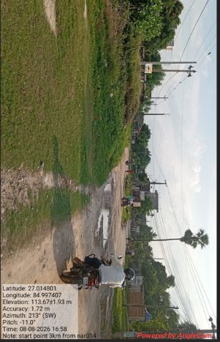
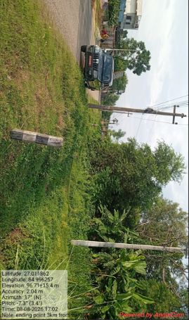
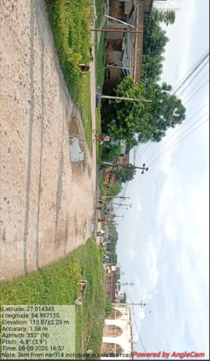
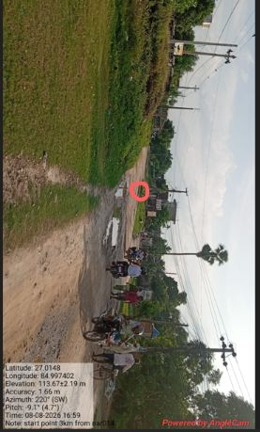
Survey from NAR014 end
1.) 3KM
Enclosure inside the road, house and not accessible.
Need to bypass approx. 2500m cable.
UG feasible but ROW required.

Slide 5
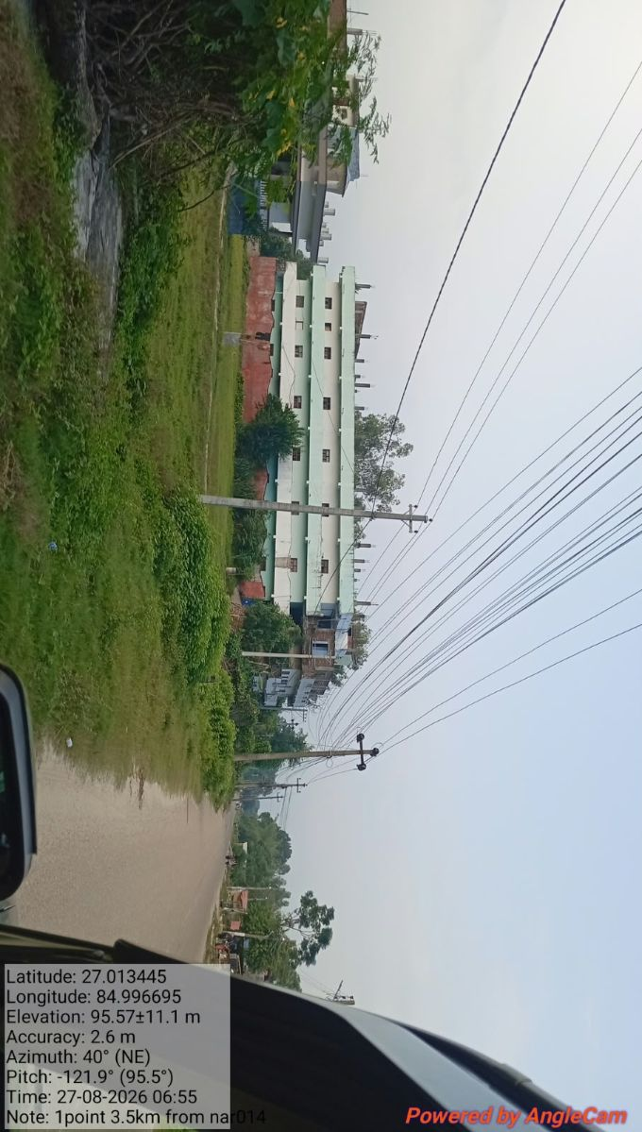
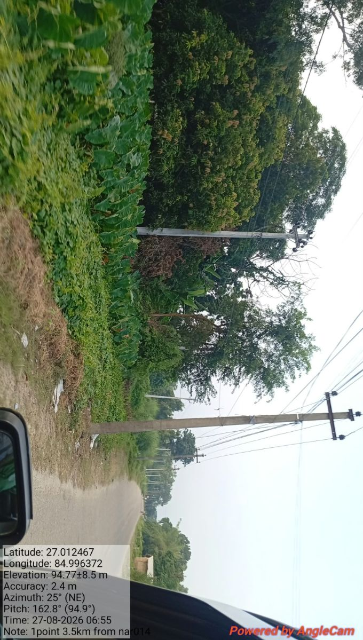
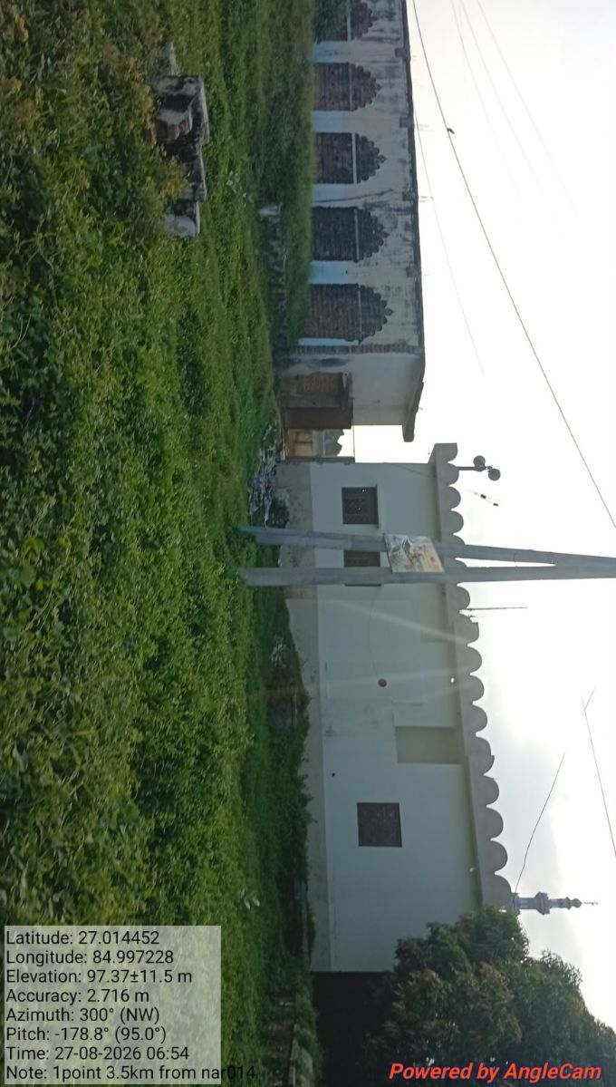
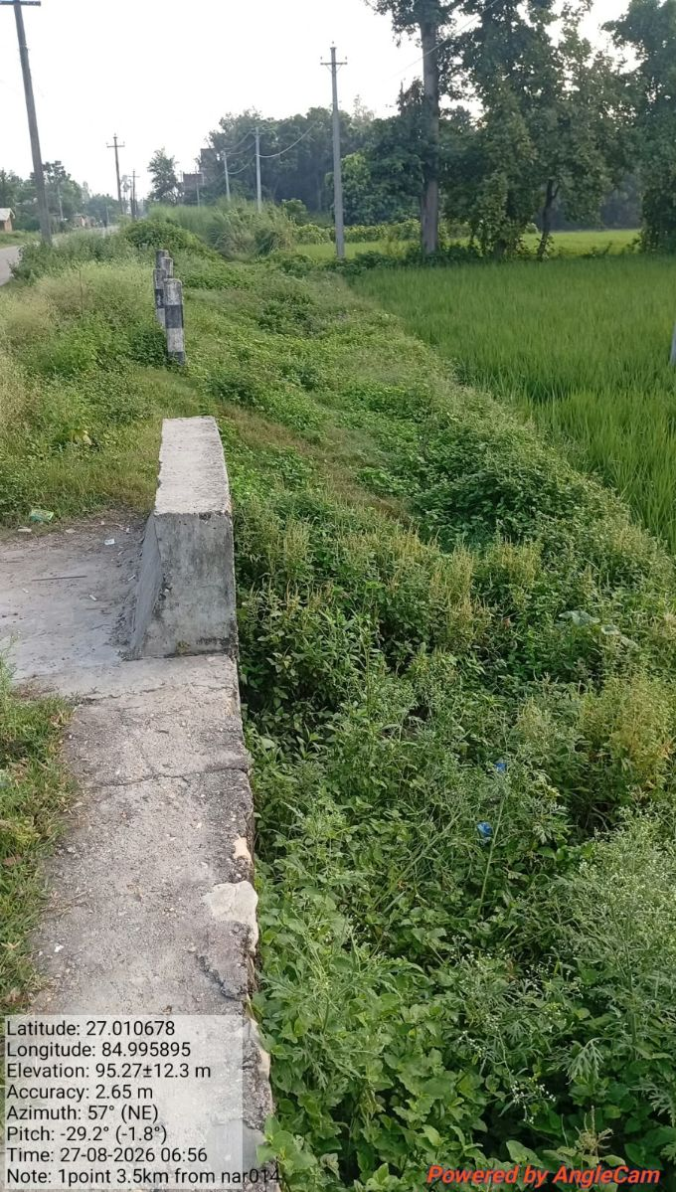
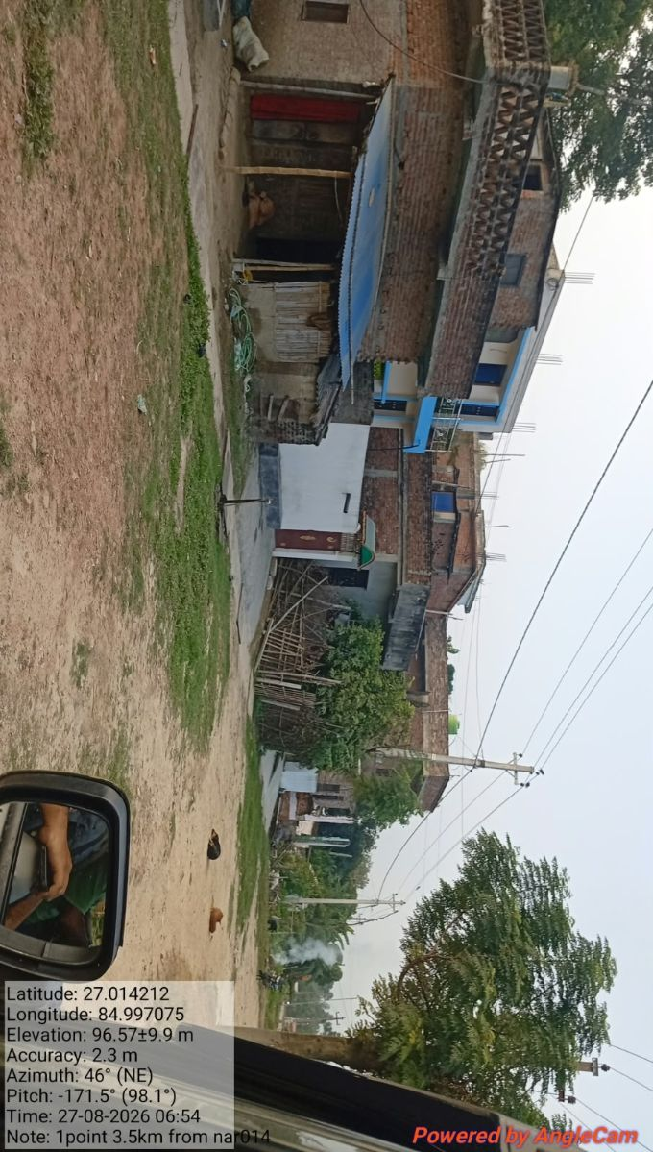
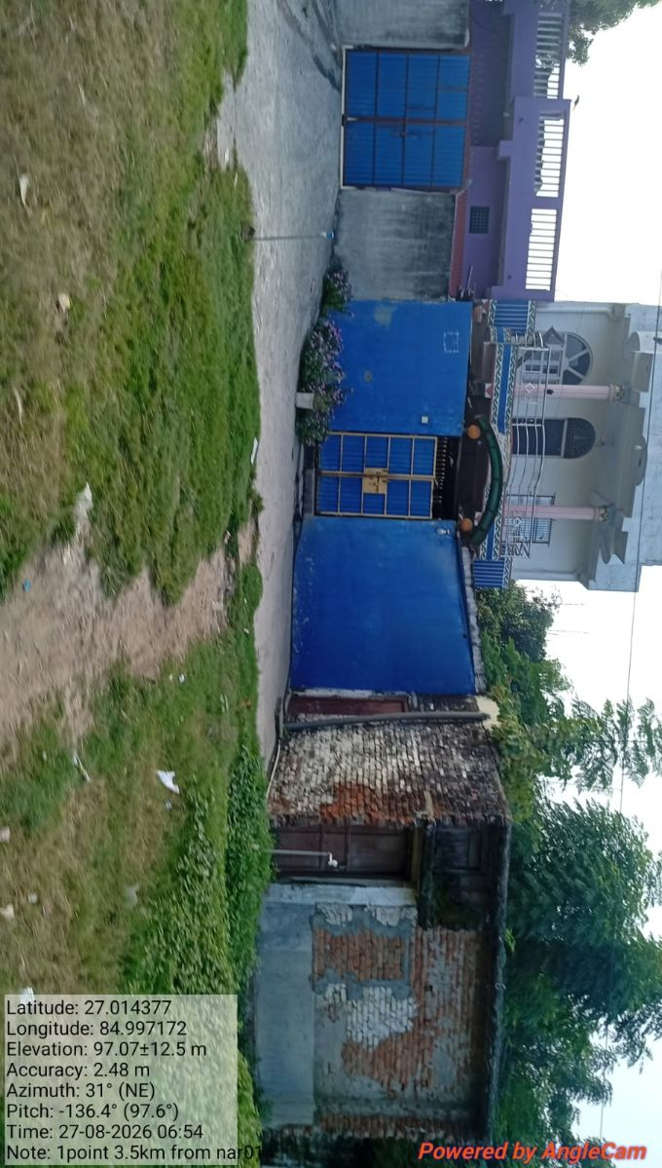
Survey from NAR014 end
1.) 3KM

Slide 6
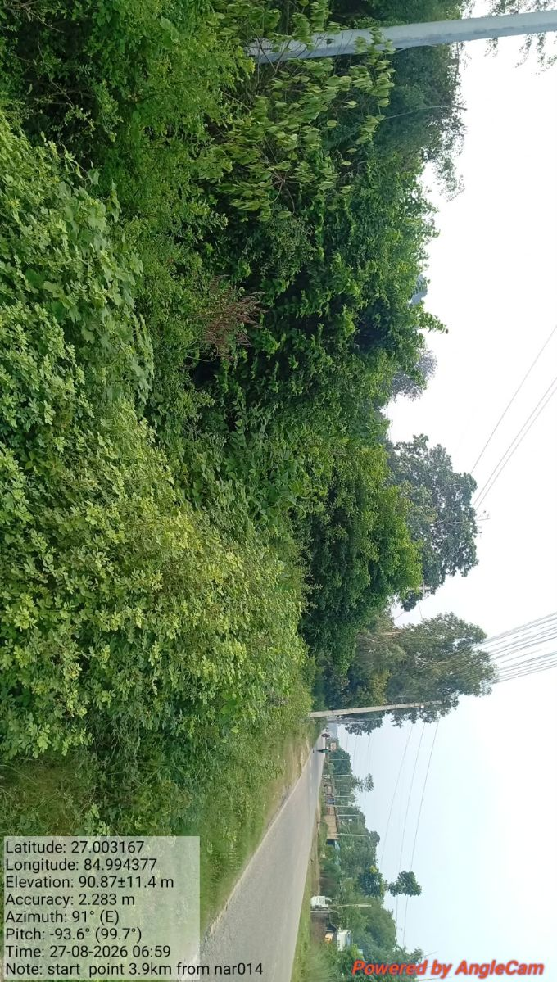
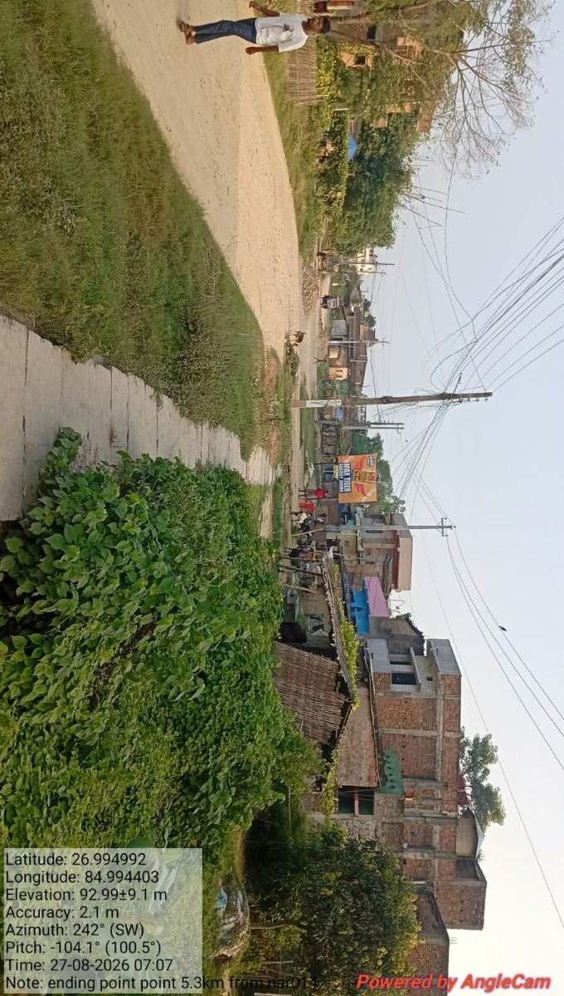
Survey from NAR014 end
1.) 3KM

Slide 7
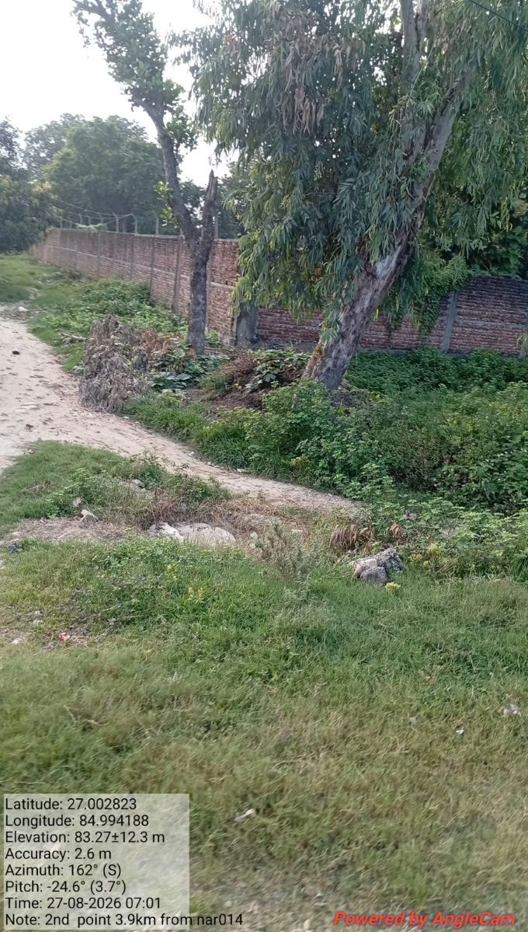
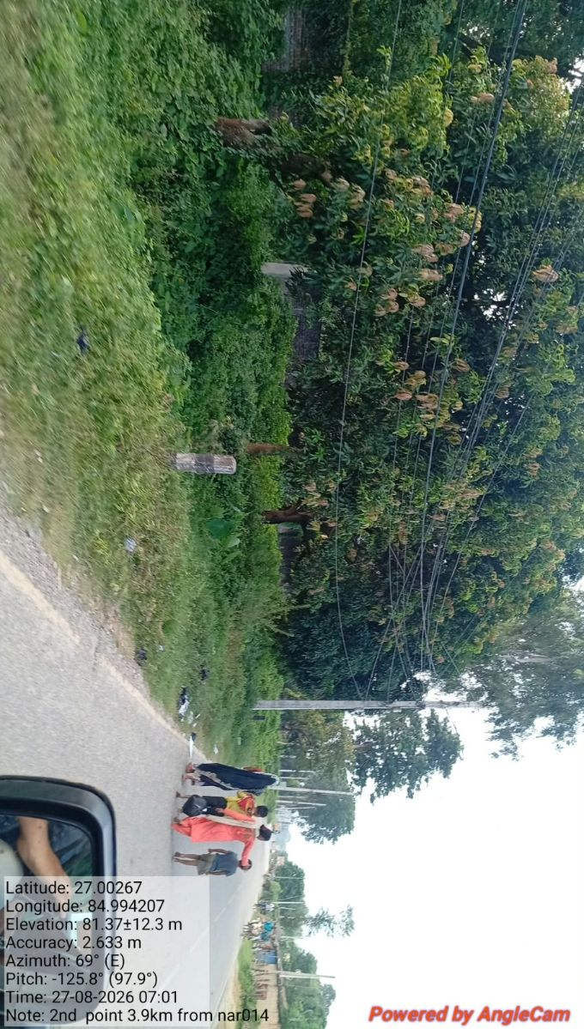
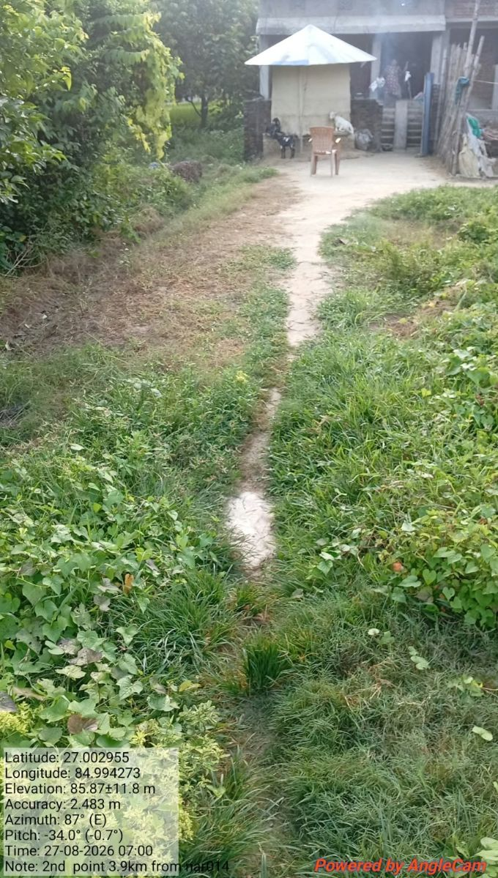
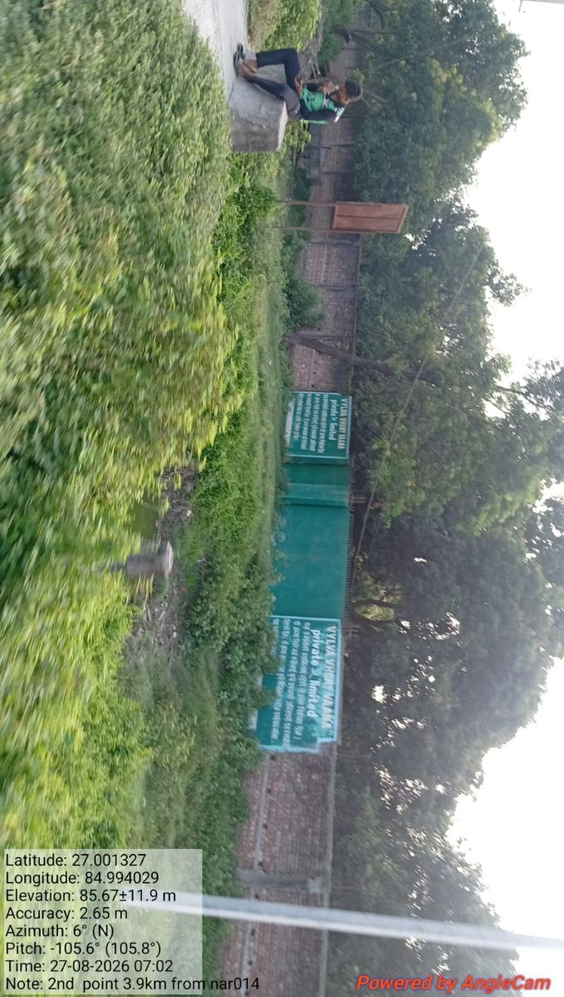
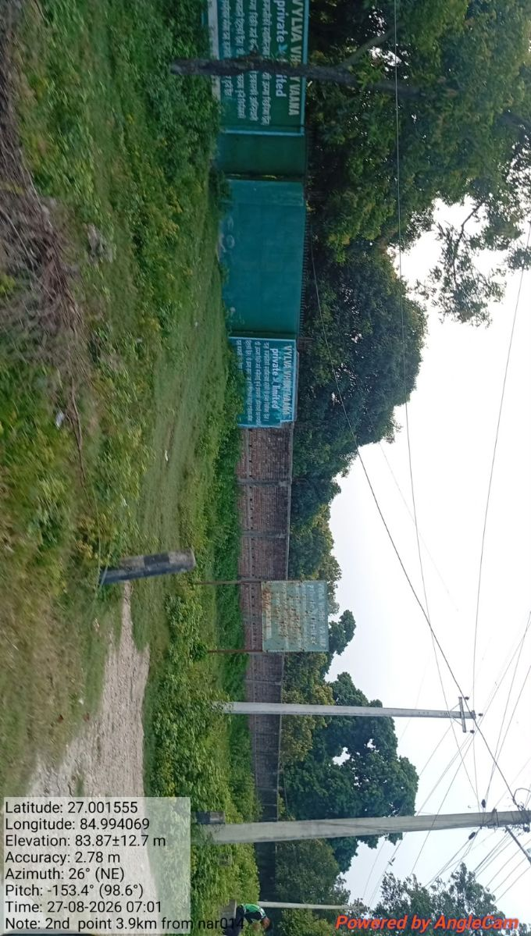
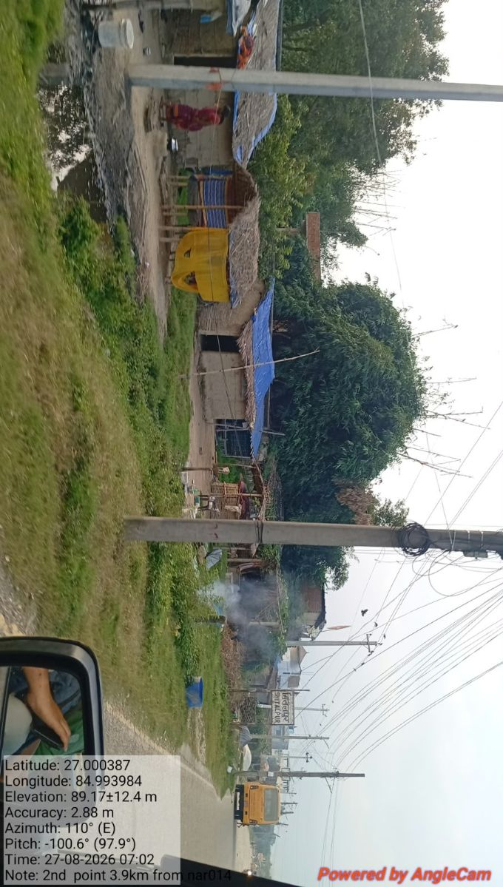
1.) 3KM

Slide 8
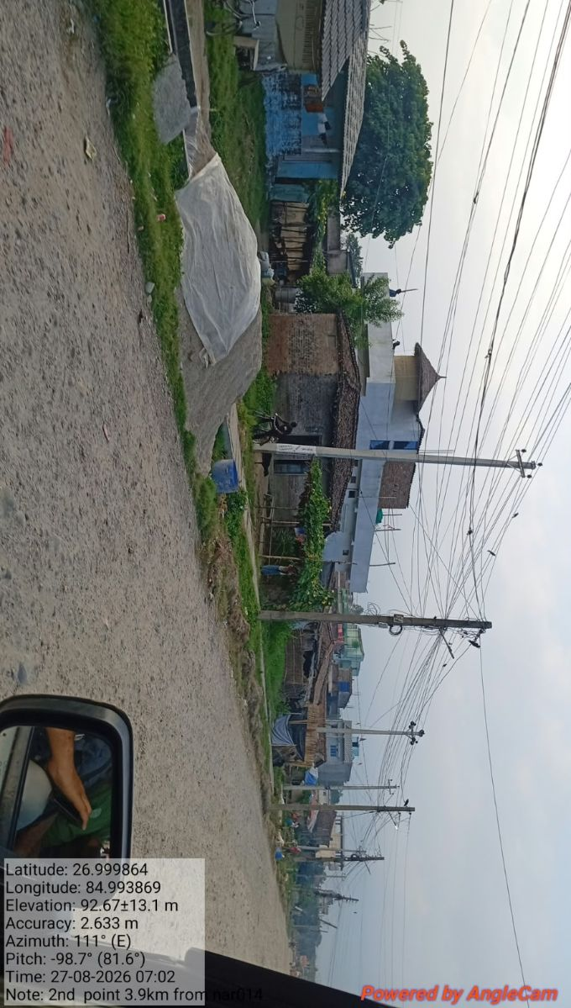
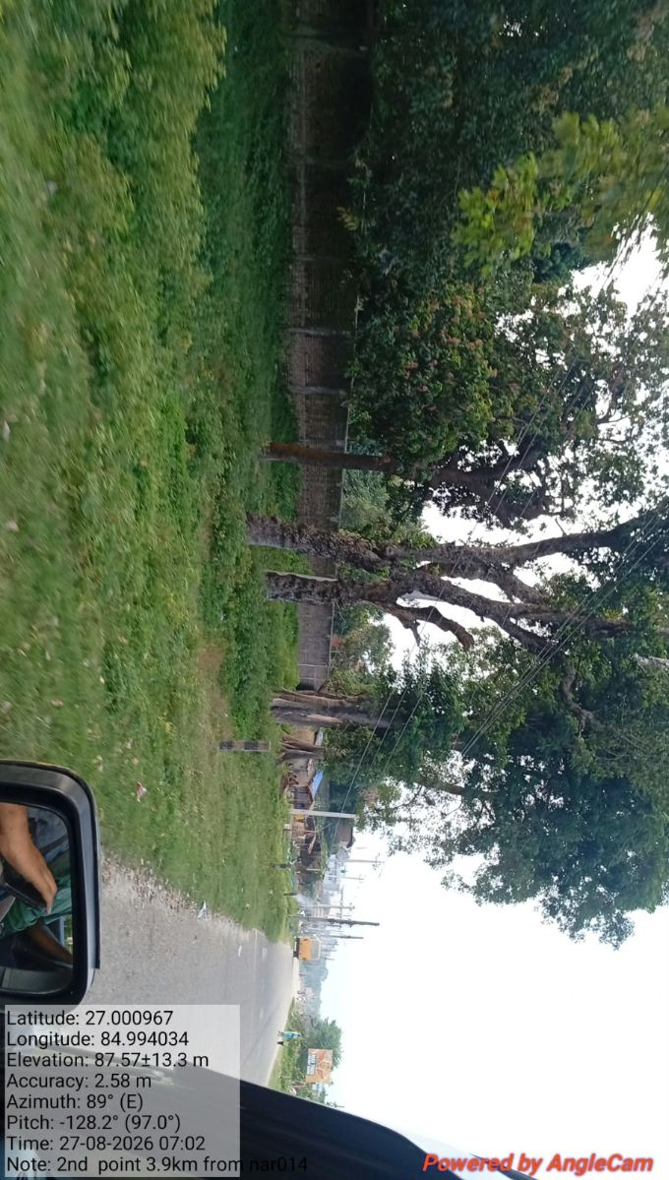
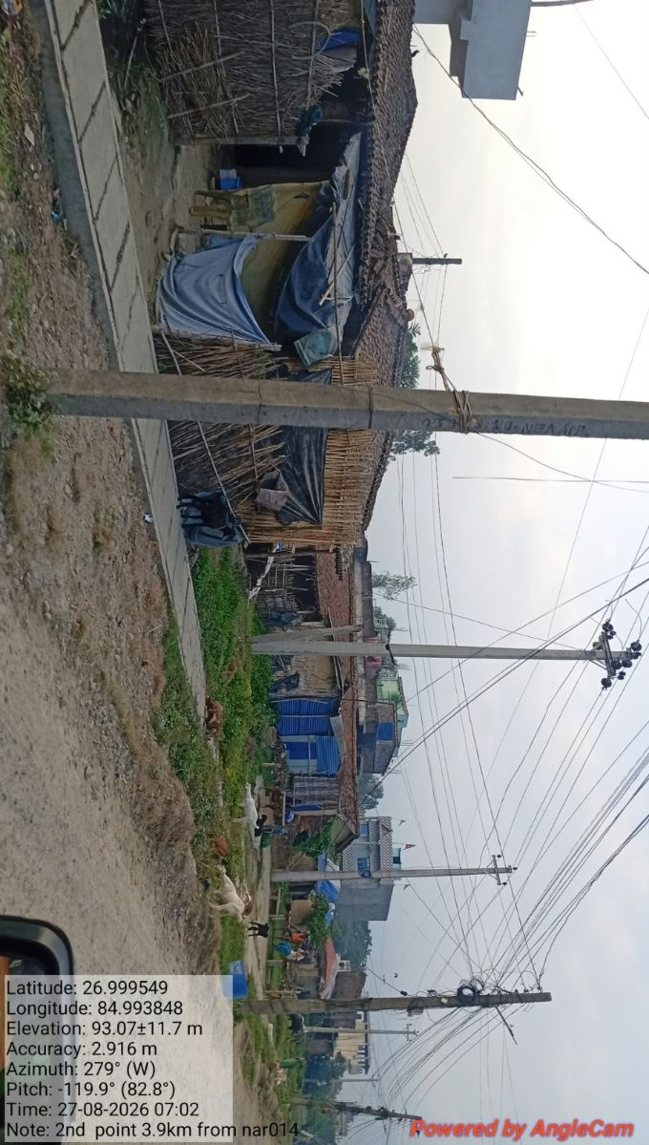
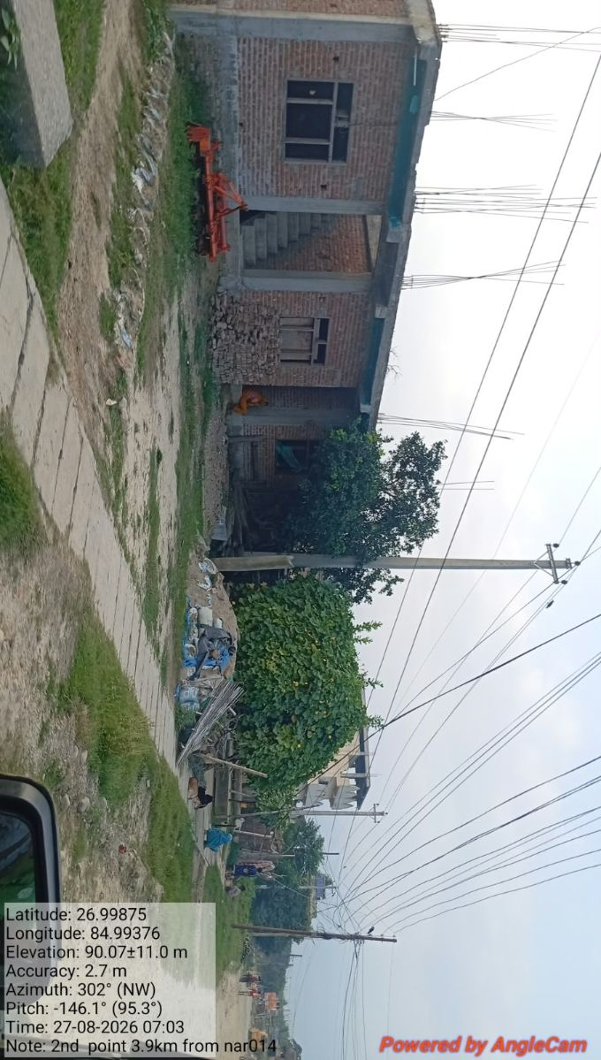
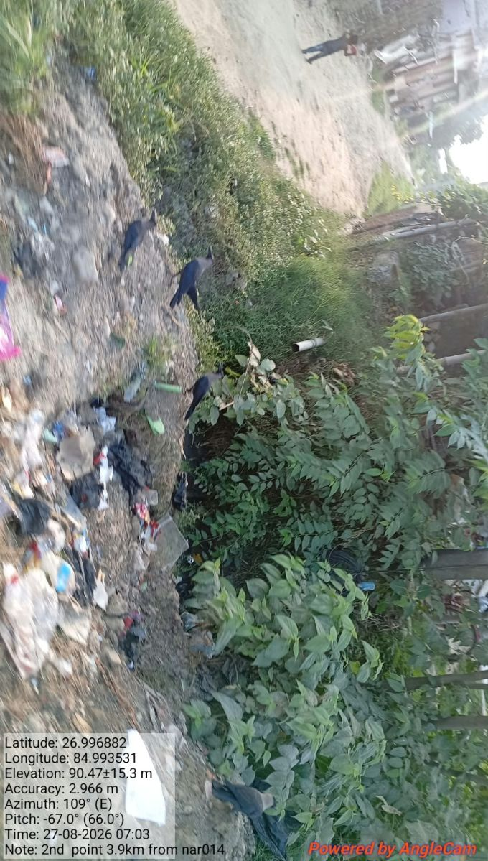
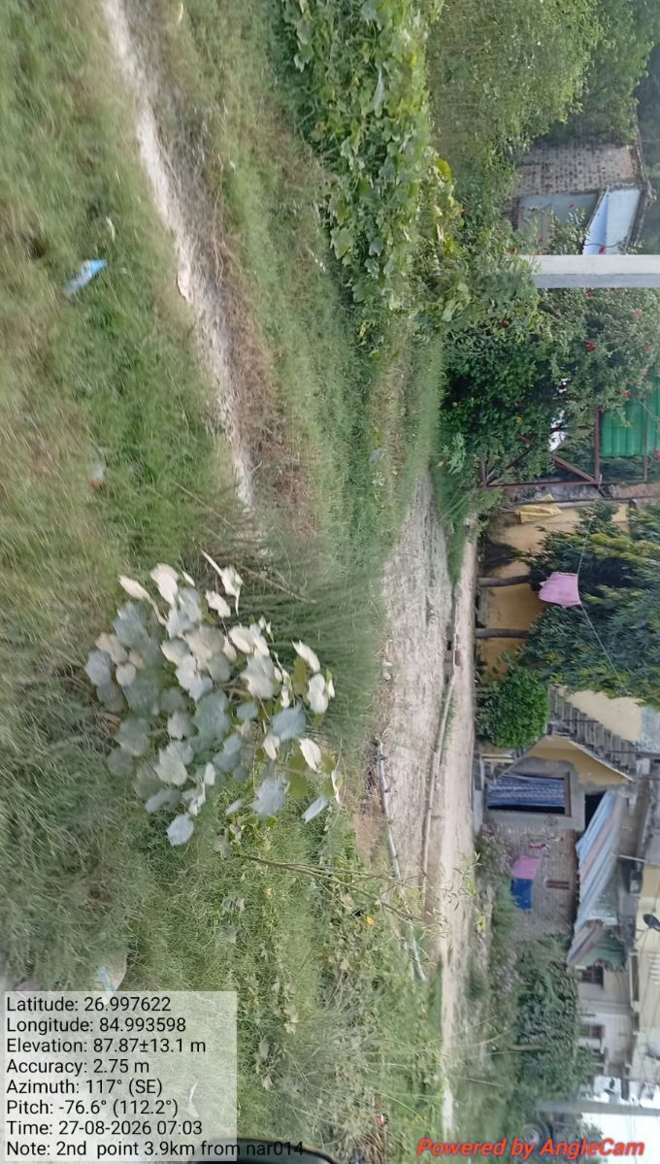
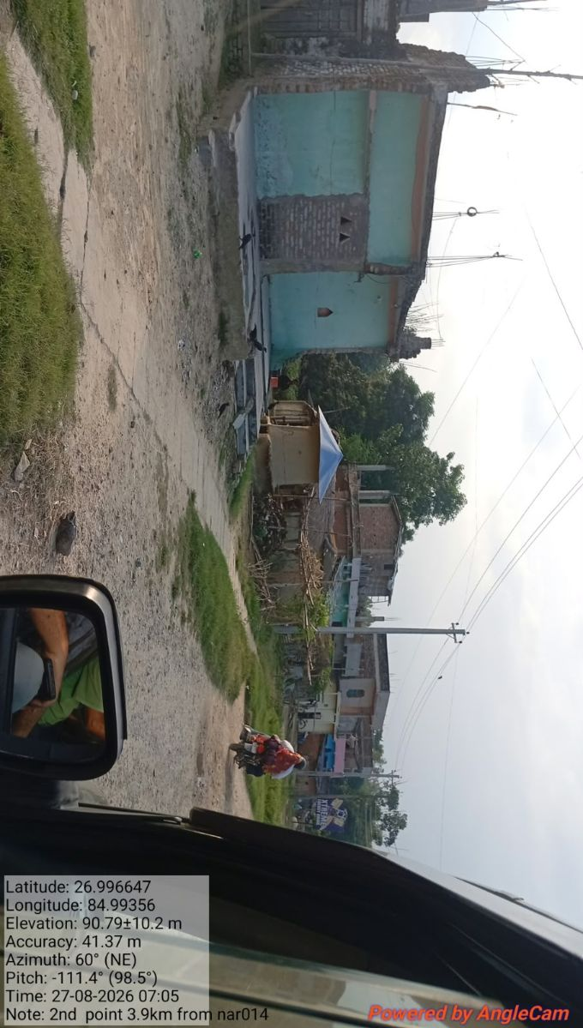
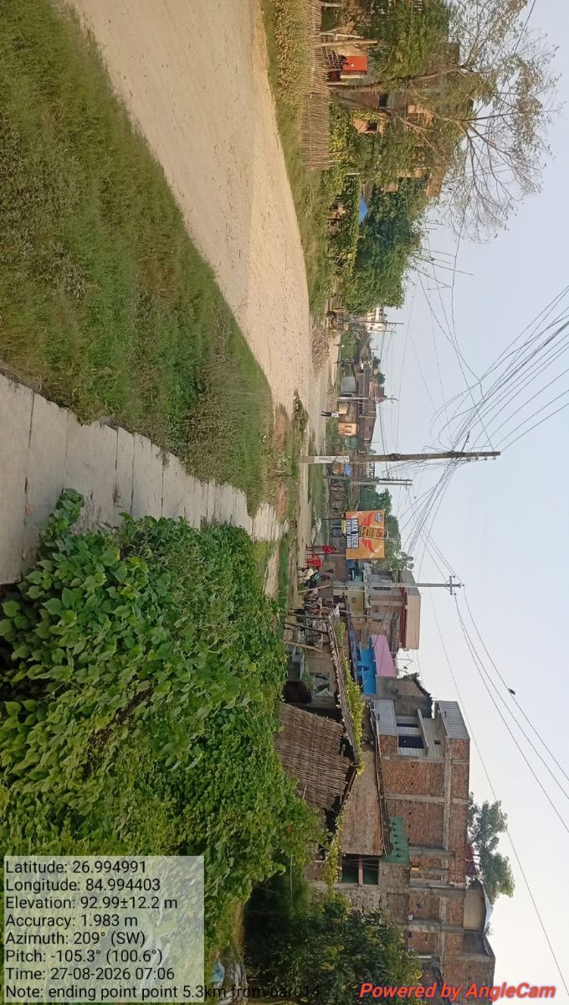
1.) 3KM

Slide 9
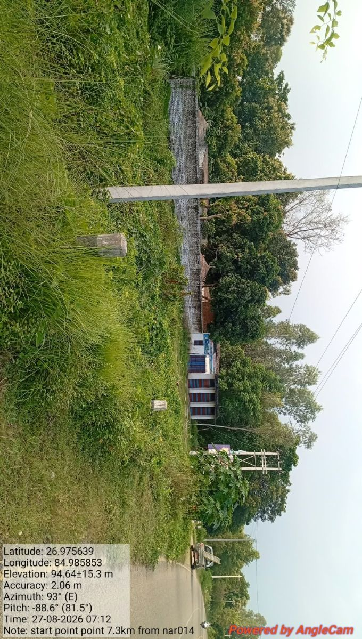
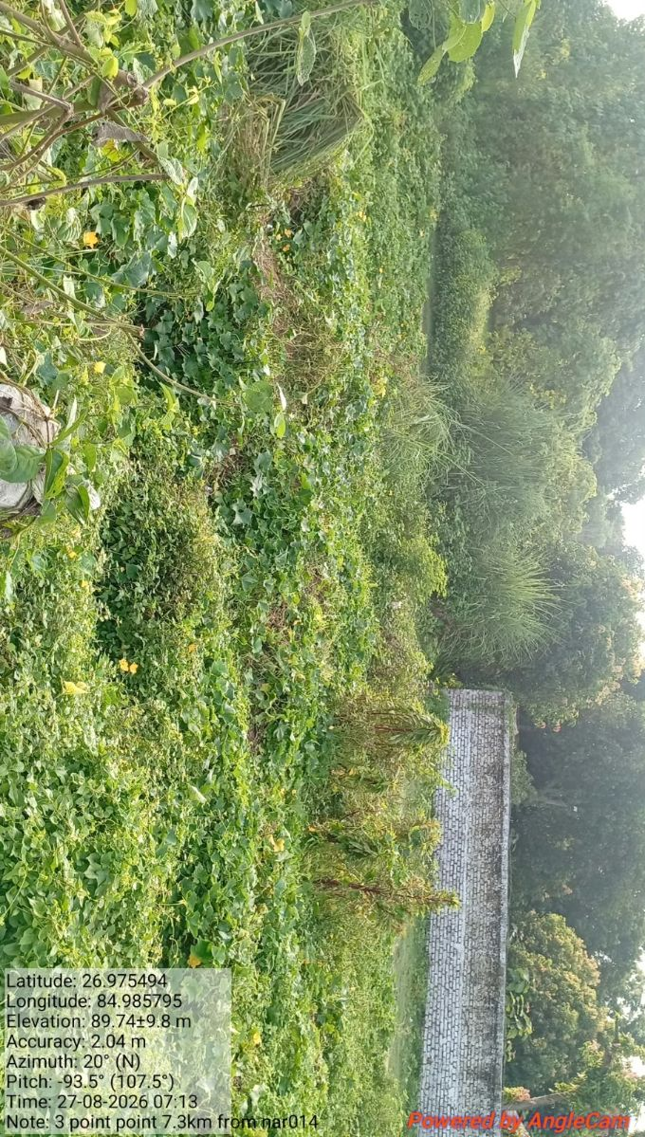
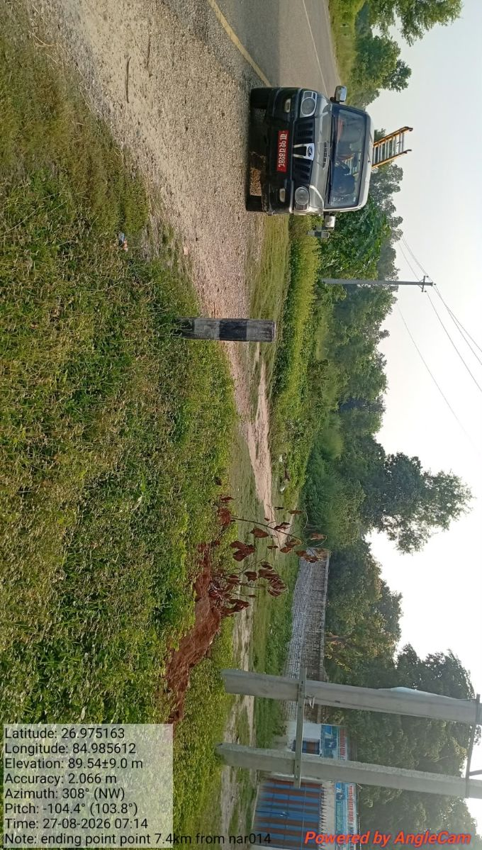
1.) 3KM

Slide 10
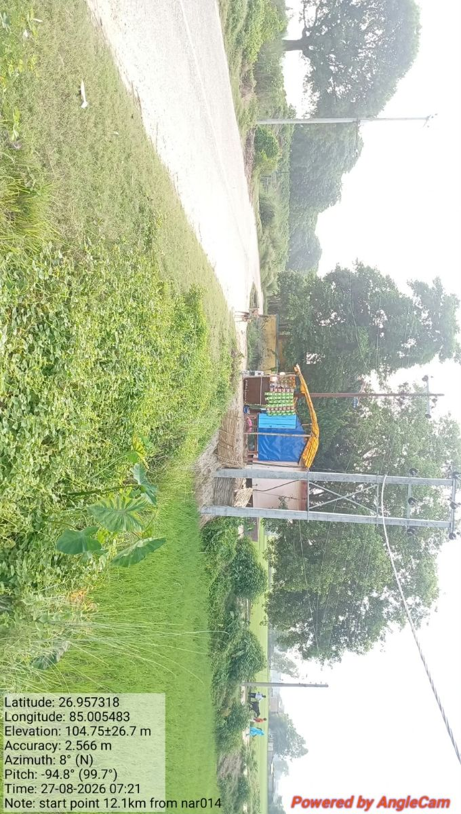
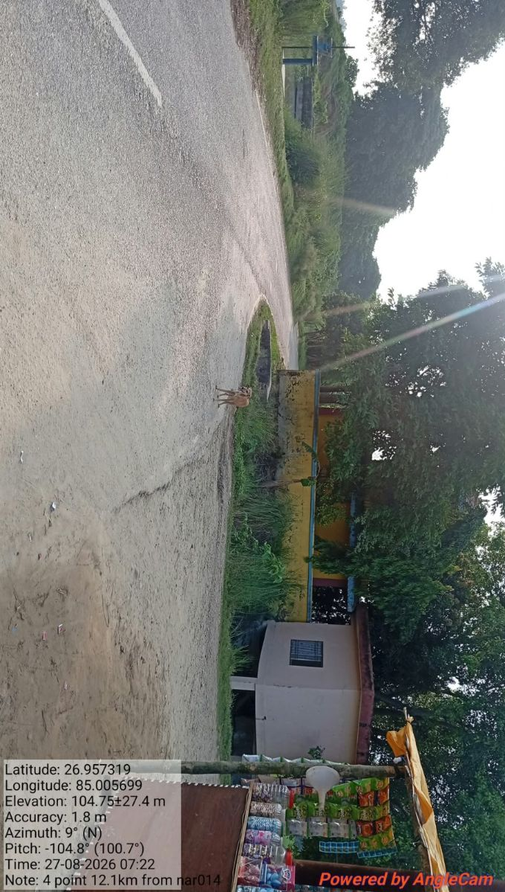
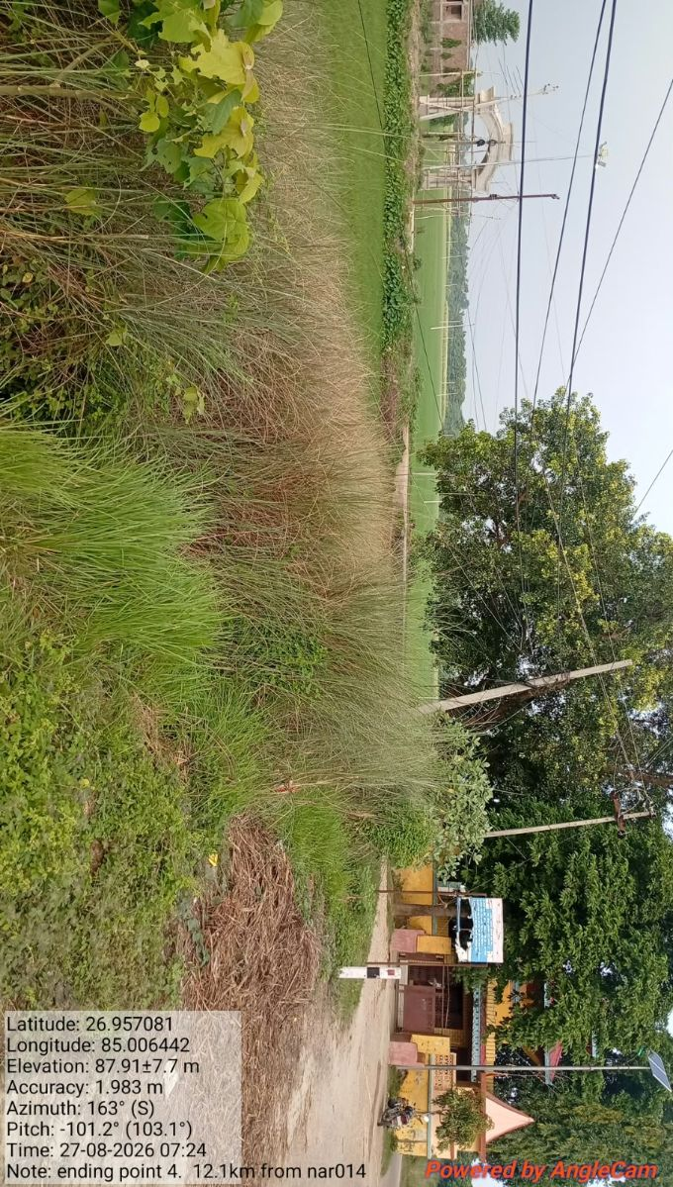
12.1KM
Location: 12.1KM from NAR014
Enclosure under the road and not accessible
Bypass section: 0.6KM
UG not feasible due to presence of temple and no space at roadside, one paved road crossing
One side is agricultural land and another side is river presence. 300m UG &300m ADSS bypass required.
Start Point
End Point

Slide 11
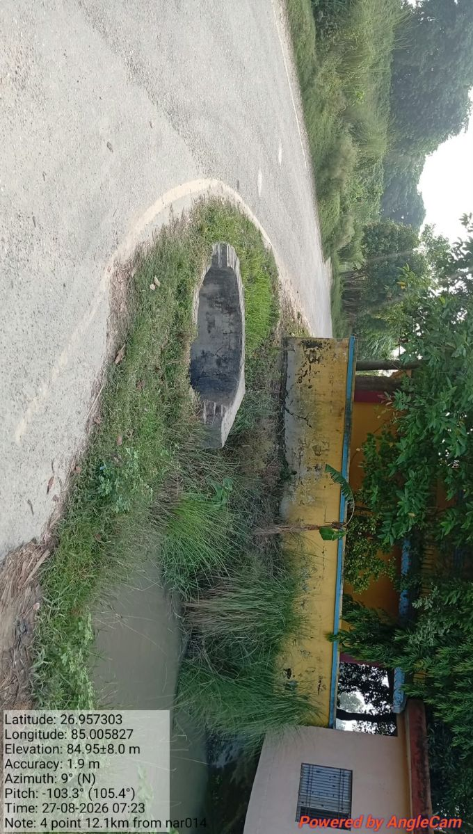
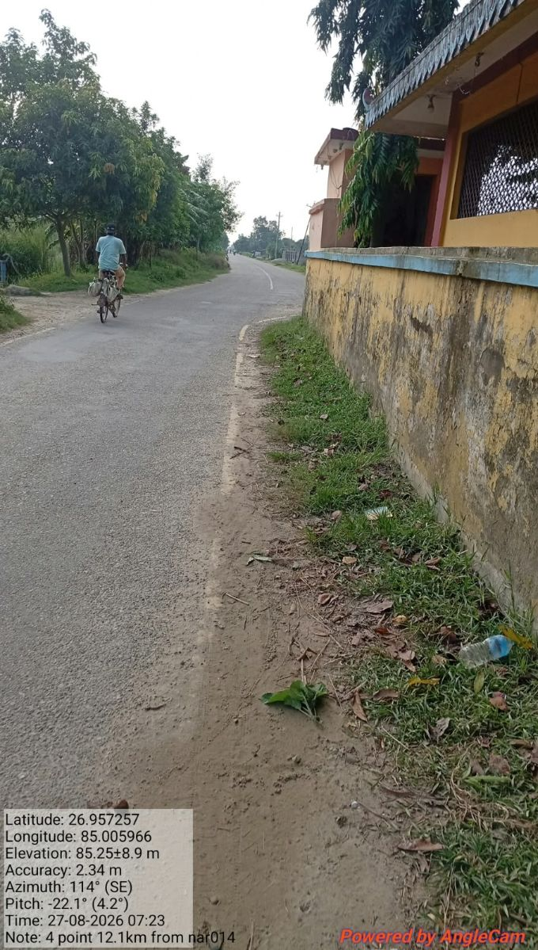
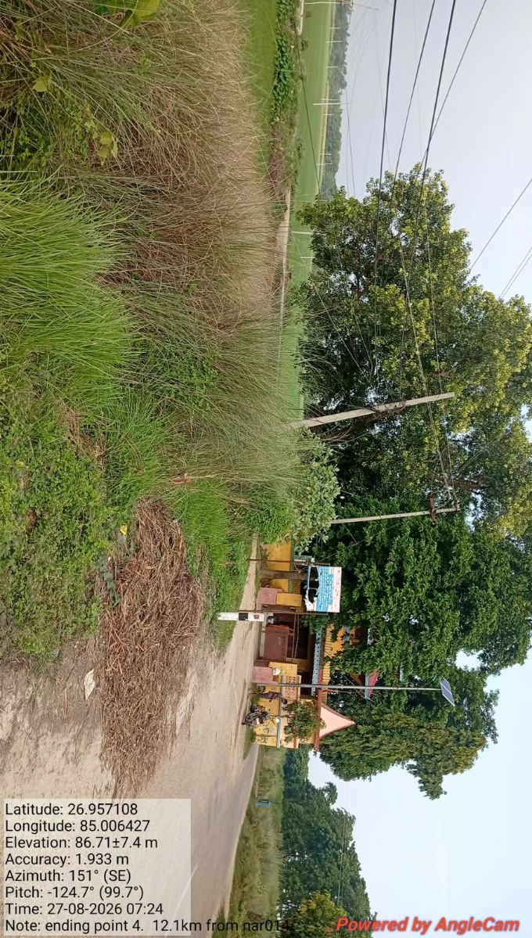
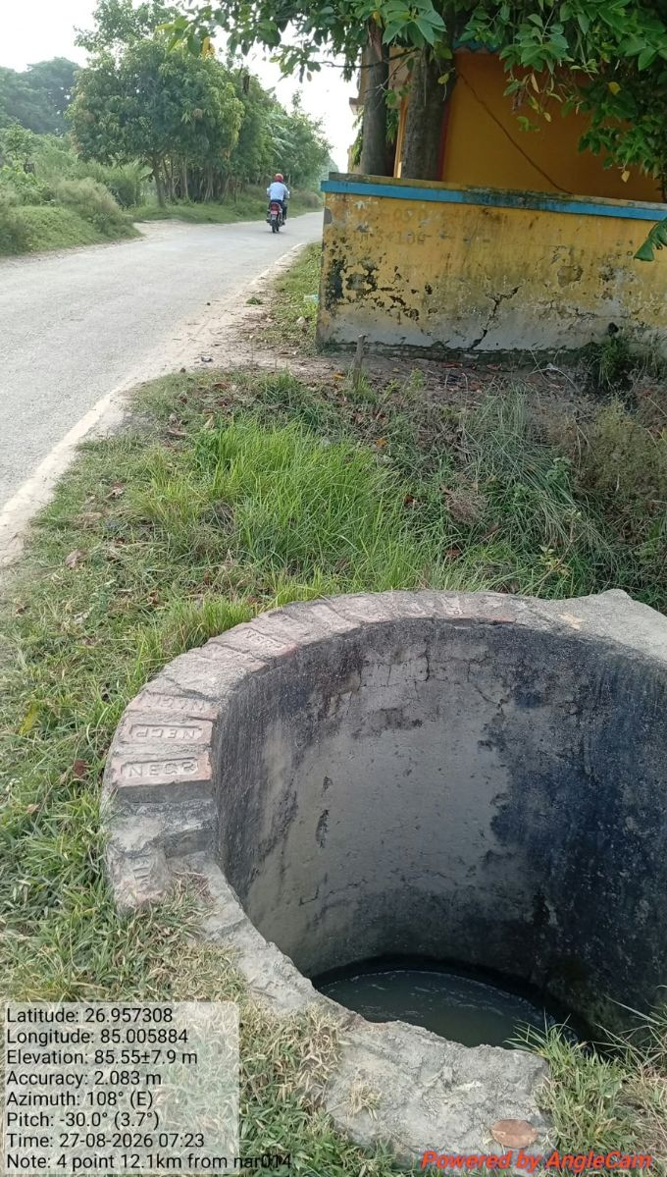
12.1KM

Slide 12
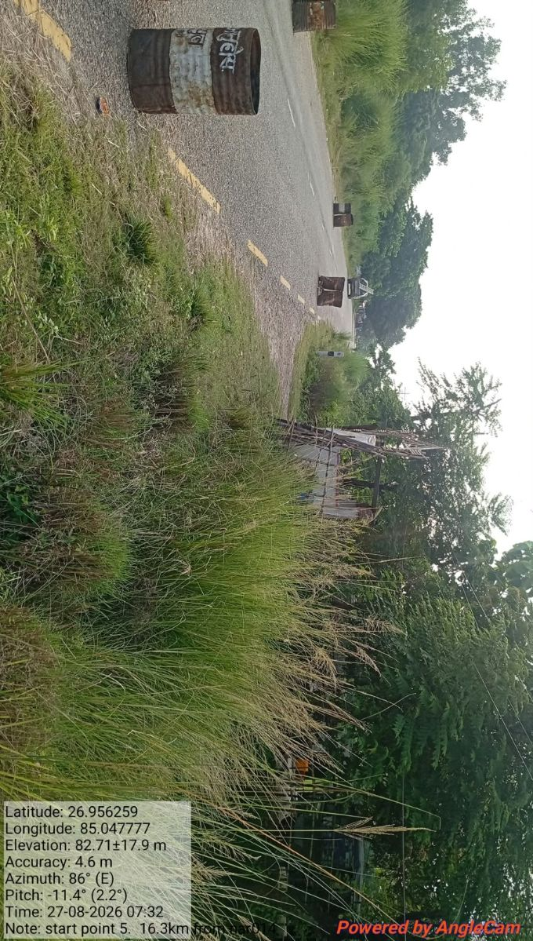
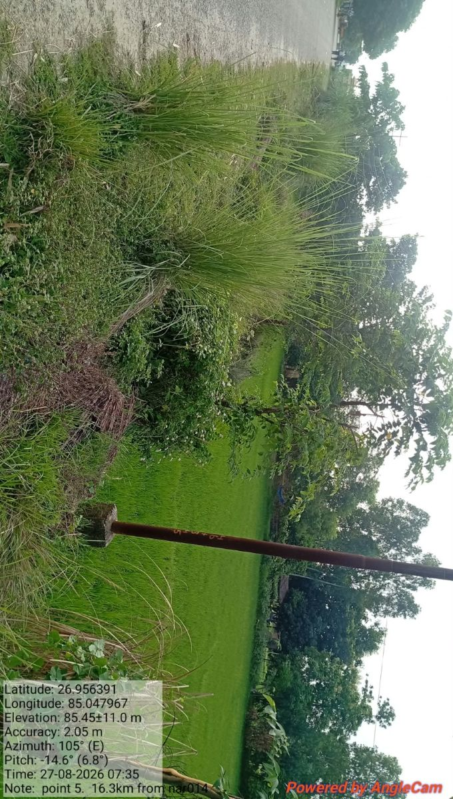
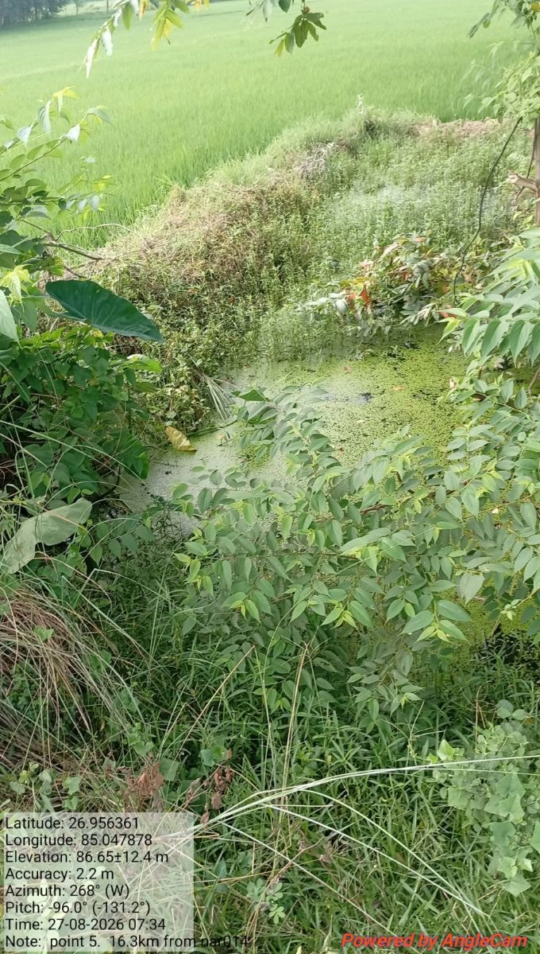
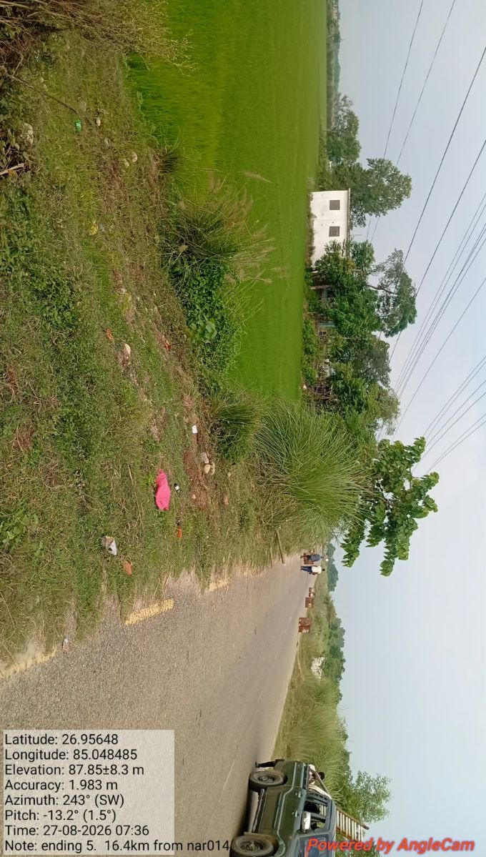
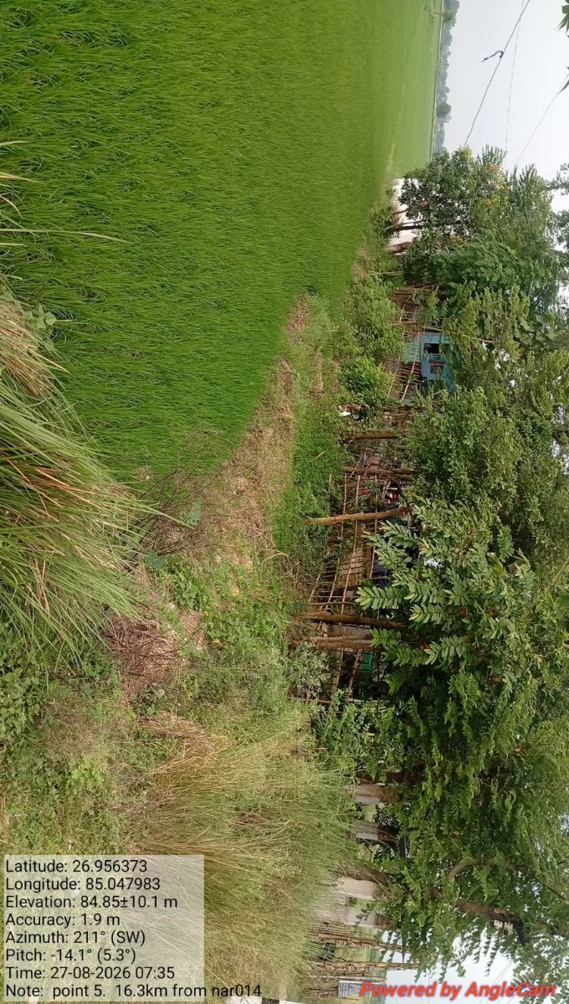
16.4KM
Enclosure under the water-logged are and not accessible for now.
Need to bypass approx. 1500m cable.
1400m UG feasible but after water drained out, crop harvesting and 100m ADSS
1 canal present, GI pipe required
12m DWC. pipe required due to home pipe

Slide 13
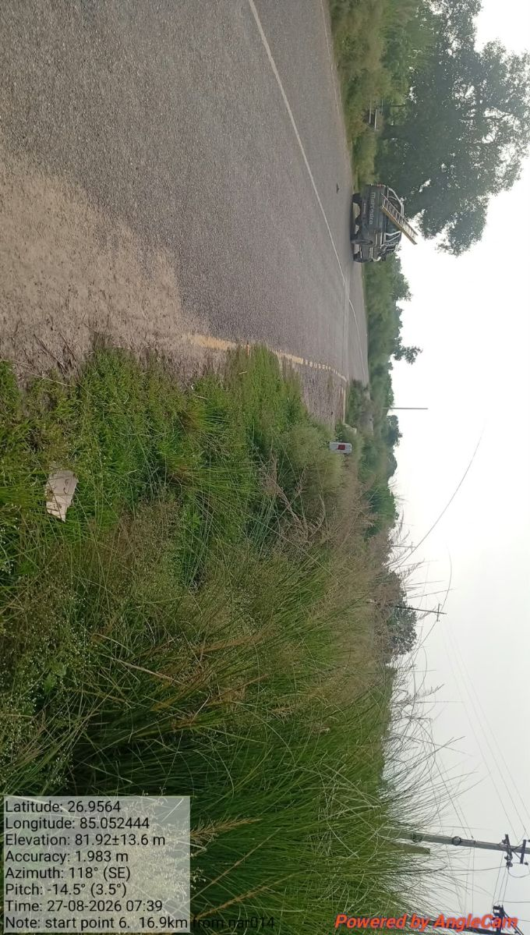
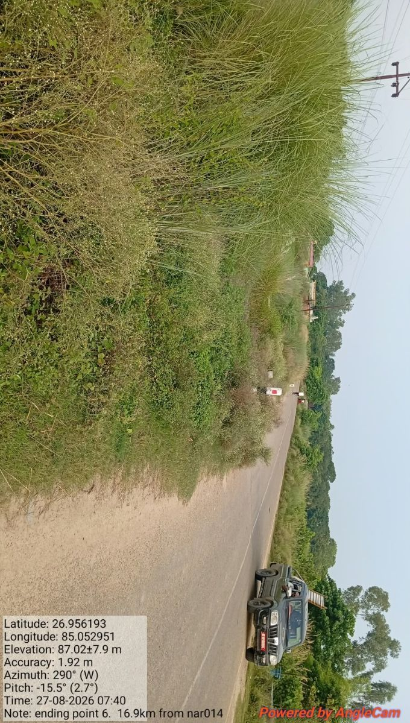
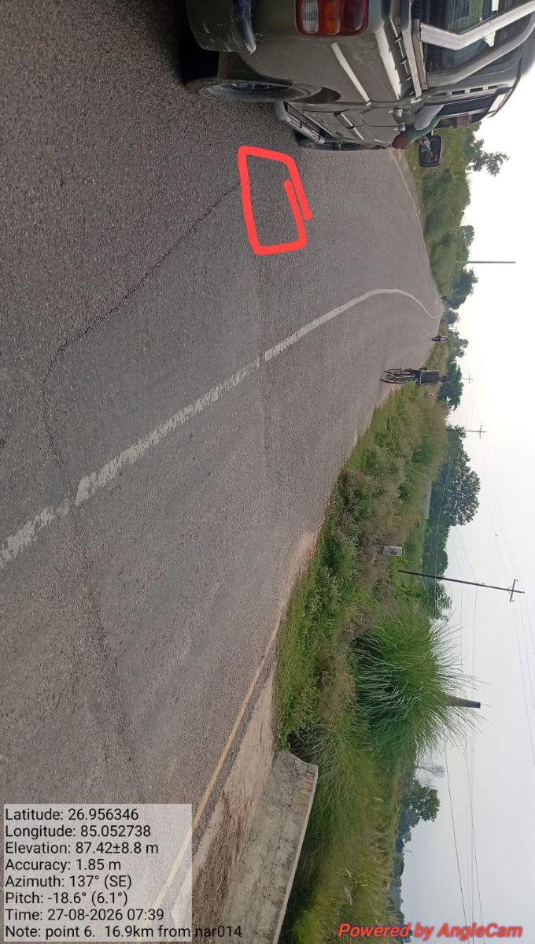
16.4KM

Slide 14
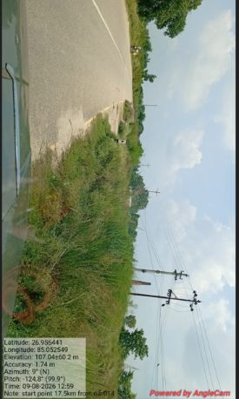
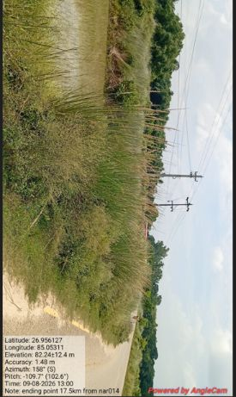
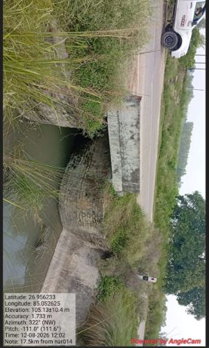
16.4KM

Slide 15
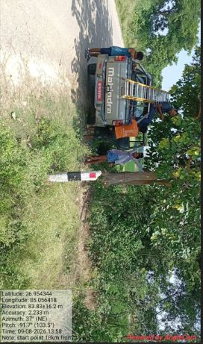
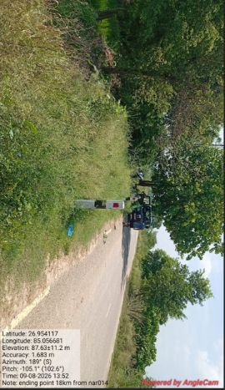
16.4KM

Slide 16
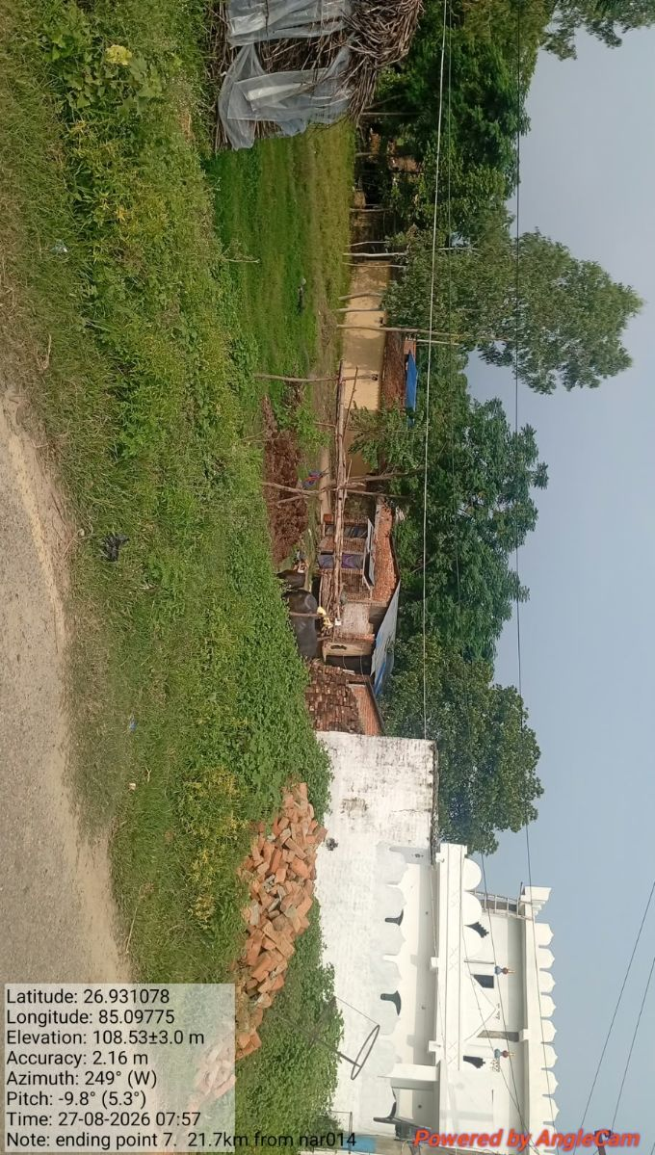

20.5KM
Location: 20.5KM from NAR014, Enclosure is under road and not accessible
Bypass section: 1.5km (500 UG 1000 ADSS)
UG permanent is not feasible due to market area, paved road, village area and no space available at road side
One side drain and another side canal present
2 Additional pole required
12m DWC. pipe required due to home pipe, PCC required
Start Point
End Point

Slide 17






20.5KM

Slide 18



20.5KM

Slide 19



20.5KM

Slide 20




24.2KM
Enclosure under the road and not accessible for now.
Approx 700 UG 1500 ADSS total 2.2km cable bypassed.
1 bridge available.
Manual trenching required on both site of bridge due to paved road
6m DWC pipe, PCC required

Slide 21


24.2KM

Slide 22






3.) 24.2KM

Slide 23




24.2KM

Slide 24






24.2KM

Slide 25


29.5KM
Location: 29.5KM from NAR014
Bypass section: 500m
UG not feasible due to no space at road side, paved road crossing and culvert presence.
NAR074 T-point will be bypass(250m ADSS). 1 pole required in road crossing for ADSS
Start Point
End Point

Slide 26



29.5KM

Slide 27


37.5KM
Location: 37.5KM from NAR014
Bypass section: 3km (2500 UG, 500 ADSS)
Approx 2500m UG feasible and 500m not feasible due to fully water-logged area, tree at road side area
Pole required for ADSS
Start Point
End Point

Slide 28




37.5KM

Slide 29




37.5KM

Slide 30





37.5KM

Slide 31



14.) 40KM

Slide 32




FROM NAR402 towards NAR050 40KM
Enclosure and fiber is under the road, house and not accessible. Existing fiber is approx. 10-12 feet
Need to bypass approx. 3.5KM cable.
2km UG feasible & 1.5KM UG not feasible due to market area, village, sand mud, paved road and no space available at roadside
Approx. 10 new poles required
End Point NAR133 site
T-point

Slide 33




40KM Snap

Slide 34




40KM Snap

Slide 35




40KM Snap

Slide 36




40KM Snap

Slide 37




40KM Snap

Slide 38



40KM Snap

Slide 39
Thanks

